Slide 1
Electronic Distribution of Science Publications
A Learn in 30
OPCUG & PATACS
April 17, 2021
Lorrin R. Garson
© Lorrin R. Garson 2021
Notes:
Last edited: April 15, 2021 @ 9:57 am

Slide 2
Outline
How scientists communicate
Science journals
Example journal article
Printing and electronic delivery
The publishing process
Creation of paper and electronic journals
Challenges to electronic publishing
Cooperative experiments
Success!

Slide 3
How Do Scientists Communicate?
Personal contact and human networking
Conferences and formal meetings
Abstracting/Indexing services
STN International (~150 databases) and SciFinder
ISI (International Scientific Indexing)
MEDLINE (NLM/NIH)
Patents (worldwide)
Science Journals (worldwide)
Notes:
STN = Scientific and Technical information Network; established in 1989
SciFinder, produced by Chemical Abstracts Service (CAS), is the most comprehensive database for the chemical literature, searchable by topic, author, substances by name or CAS Registry Number, OR use the editor to draw chemical structures, substructures, or reactions. It's a core research tool for chemistry, biochemistry, chemical engineering, materials science, nanotechnology, physics, environmental science and other science and engineering disciplines. Depending on your research, SciFinder is complementary to other databases like Reaxys, Web of Science, PubMed, Compendex and INSPEC.

Slide 4
What Is a Journal?
The dominant means of communicating science—the historical record
Articles written by active scientists (not journalists)
Articles highly structured, technical and detailed
Articles screened by a journal editor (scientist)
Submitted manuscripts are peer reviewed
In STM—English dominate language
Notes:
Comments

Slide 5
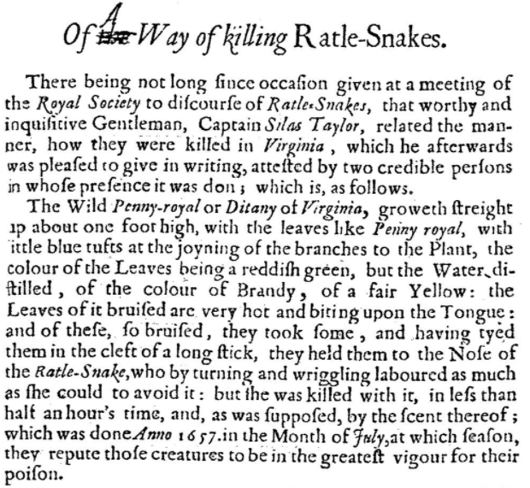
From the Philosophical Transactions of the Royal Society, vol 1, March 1665
[First science journal: Journal des sçavans (January 1665)]
Notes:
Comments

Slide 6
Chemistry Journals
~ 1,500 journals of interest to chemists
~ 95% published by commercial publishers
~ 5% published by not-for-profit organizations
European Chemical Society (50 member societies*)
The Royal Society of Chemistry—44 journals
Gesellschaft Deutscher Chemiker—10 journals
American Chemical Society—75 journals
* American Chemical Society (ACS) is an affiliate member
Notes:
Comments

Slide 7
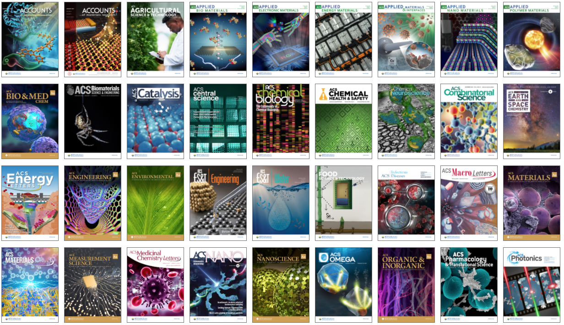
ACS Journals: 36 of 75
Notes:
From https://pubs.acs.org/

Slide 8
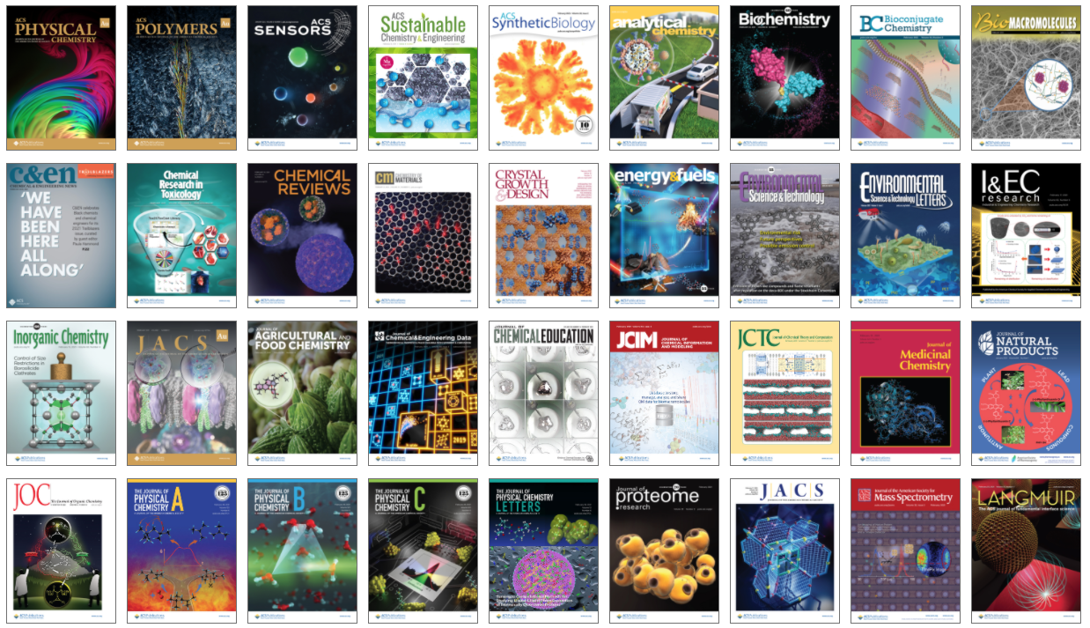
ACS Journals: another 36 of 75
Notes:
From https://pubs.acs.org/

Slide 9
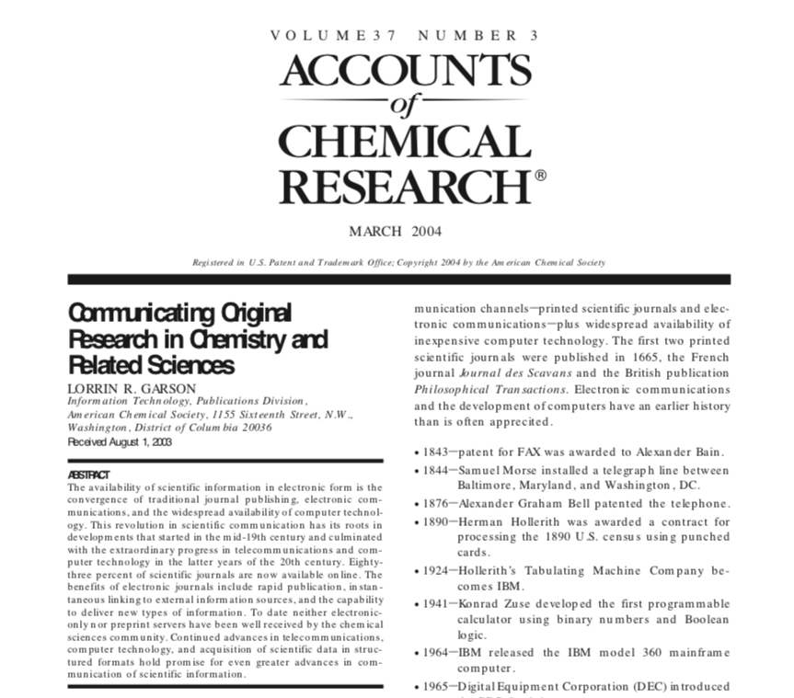
Journal Title ➔
Title ➔
Title ➔
Author ➔
Abstract ➔
Notes:
Comments

Slide 10
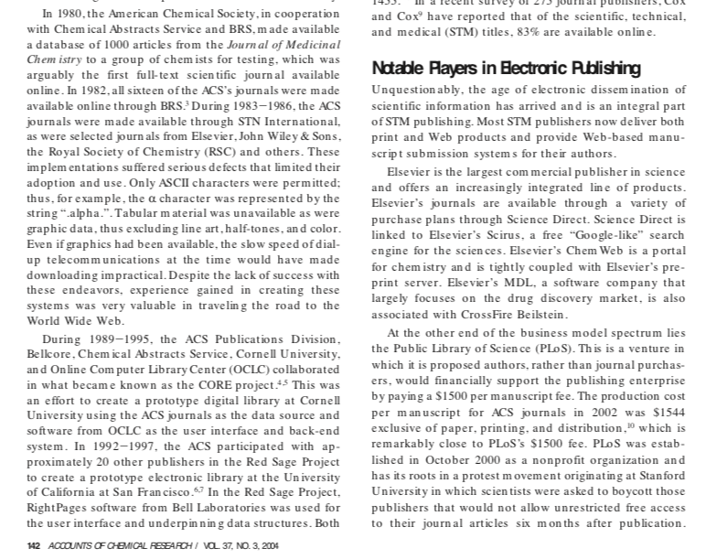
Discussion
Notes:
From https://pubs.acs.org/

Slide 11
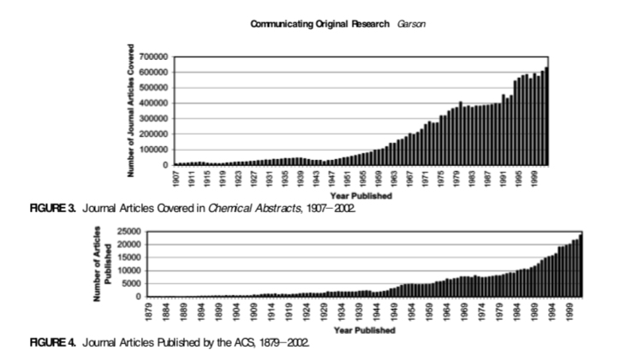
Graphics (B&W)
Notes:
Comments

Slide 12
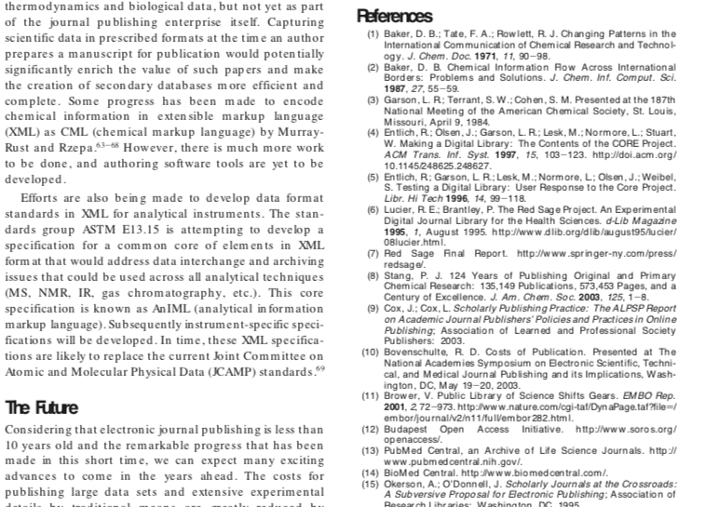
References
Notes:
Comments

Slide 13
Articles Often Also Contain…
Notes:
Comments

Slide 14
Special Characters
Greek Alphabet
Notes:
Comments

Slide 15
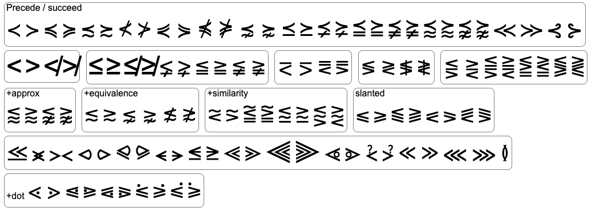
Special Characters (cont.)
Notes:
Comments

Slide 16
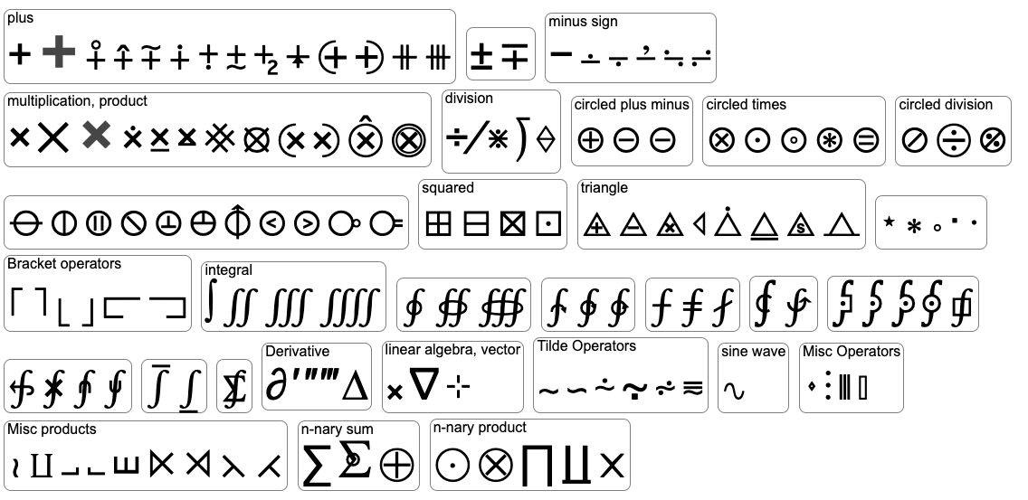
Special Characters (cont.)
And many more…
Notes:
Comments

Slide 17
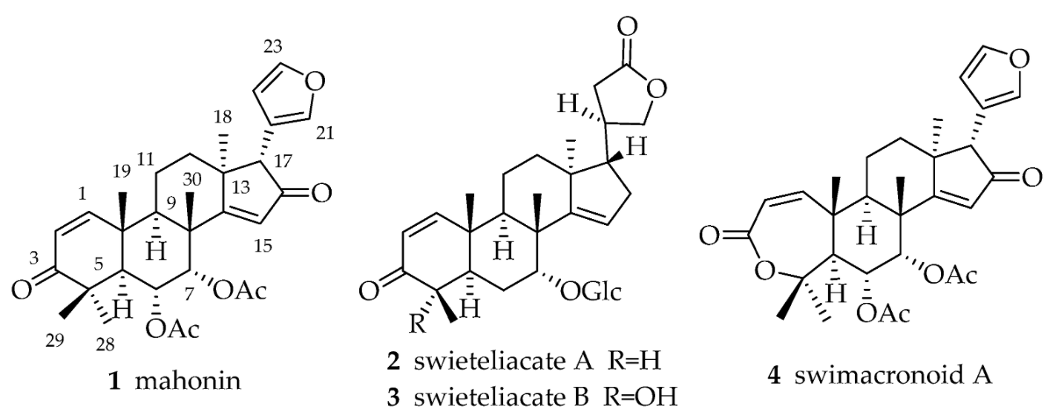
Chemical Structures
Historically drawn by hand
Keyboarded by highly skilled staff
Created using software
Information retrievable
by structure and
sub-structure searching
(181+ million substances)
Notes:
Comments

Slide 18
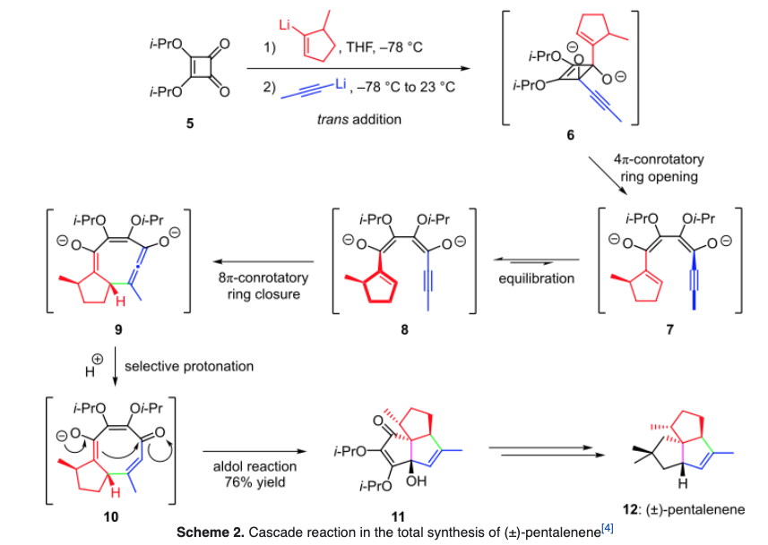
Chemical Reaction Sequences
Notes:
Comments

Slide 19
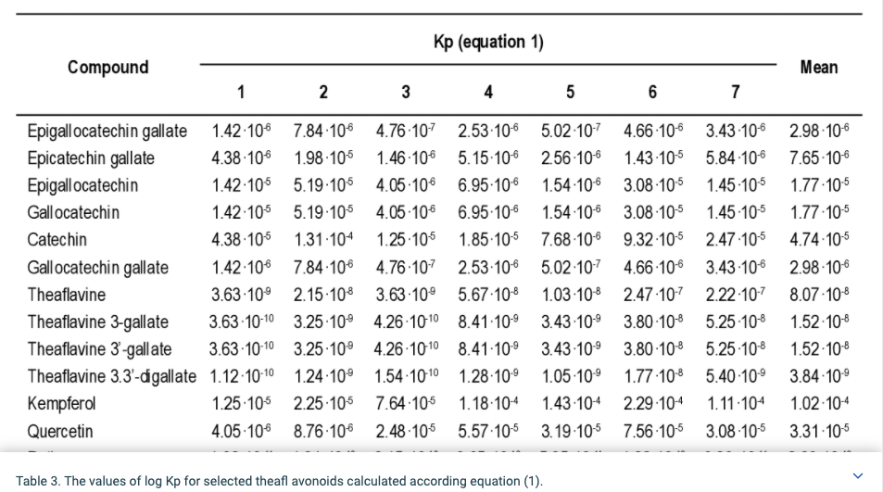
Tables
Notes:
Comments

Slide 20
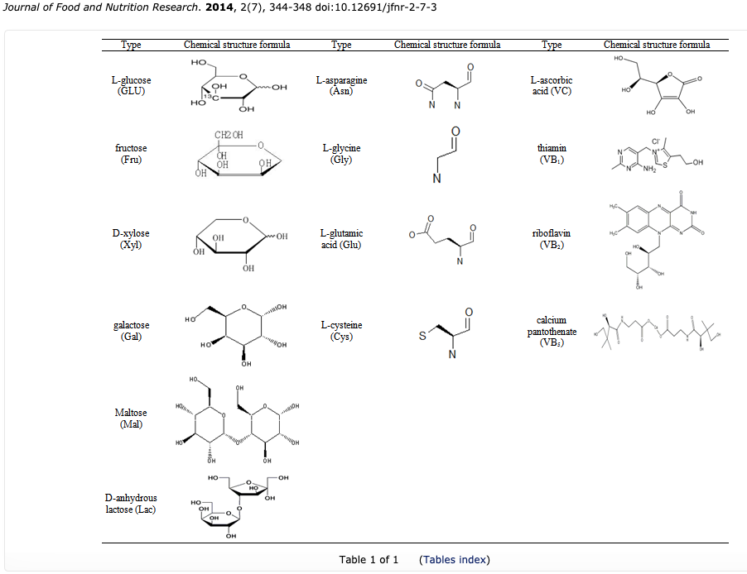
Tables
Notes:
Comments

Slide 21
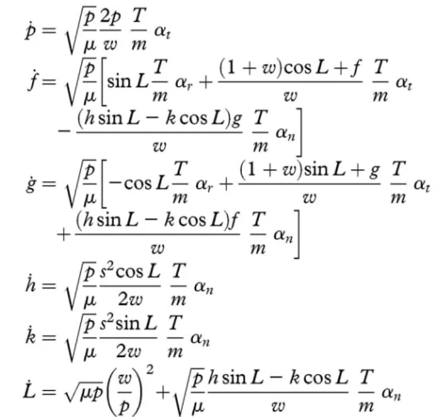
Complex Mathematics
Notes:
Comments

Slide 22
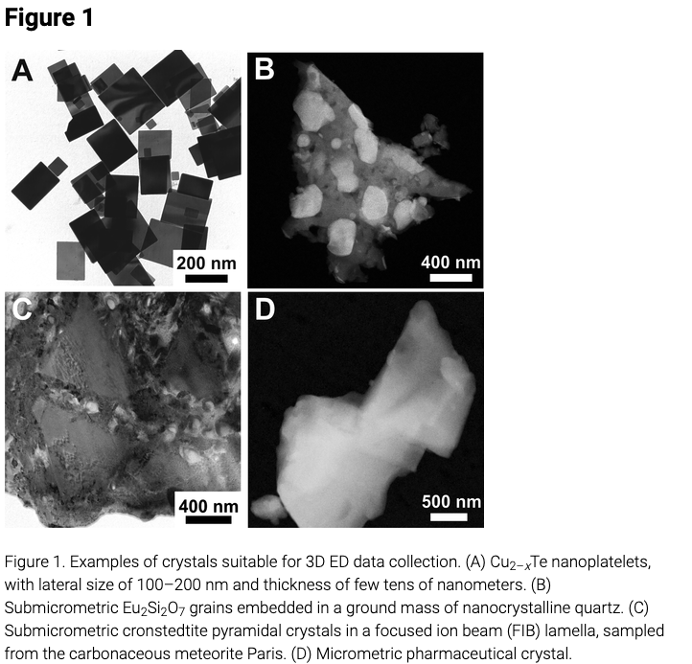
Photographs (B&W)
Notes:
Comments

Slide 23
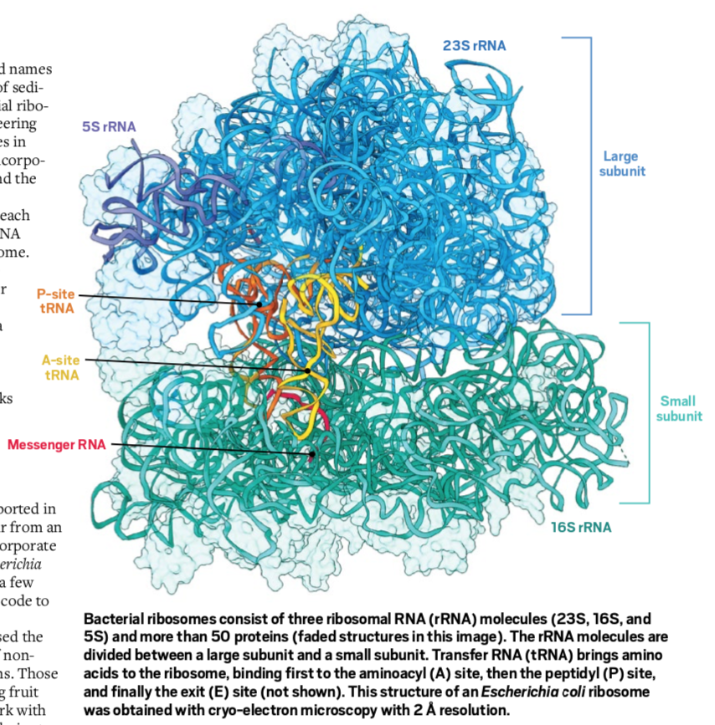
Complex Molecules and Color
Notes:
Comments

Slide 24
Mass Spectrum—Cholesterol
Notes:
Comments

Slide 25
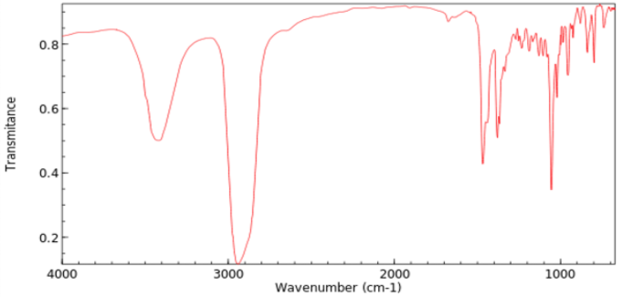
IR Spectrum—Cholesterol
Notes:
Comments

Slide 26
Publishing Chemistry—the Most Complex in STM
Notes:
Comments

Slide 27
Composition Systems
Think Microsoft Word on steroids “Super Word”
adjust objects positions ± 0.001 in
create printing templates 4, 8, 16 pp/“sheet”
Historically focus on traditional printing
Manuscripts ➔ Printed pages in journal issues
Modern composition systems also accommodate electronic publishing
Manuscripts ➔ Printed pages [and] PDF, HTML, search fields, etc.
Notes:
Comments

Slide 28
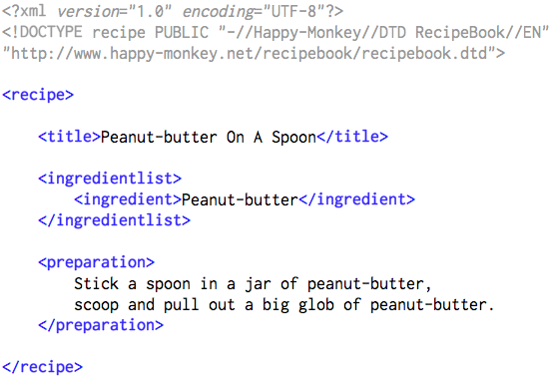
Internal Markup—XML
Begin 
Begin 
Begin 
Begin 
 End
Begin 
Begin 
 End
 End
Begin 
 End
 End
End 
For more information see
Notes:
XML = eXtensible Markup Language

Slide 29
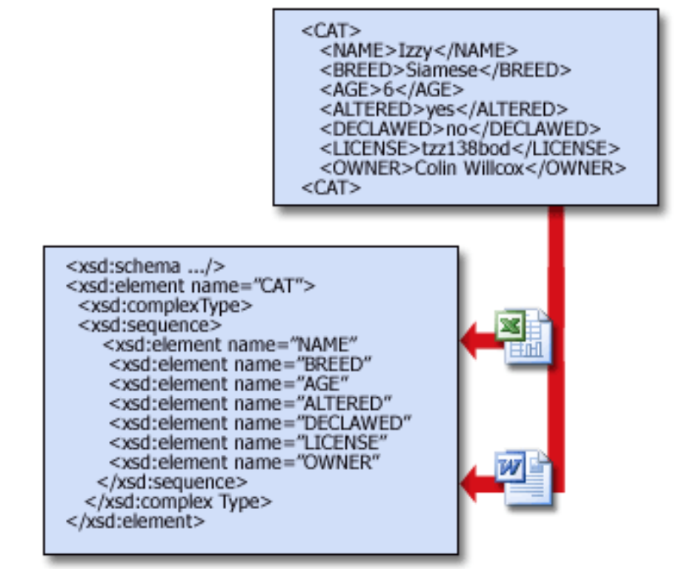
Microsoft 365
XML encoding
From
Begin 
Excel
Word
End 
Notes:
Comments

Slide 30
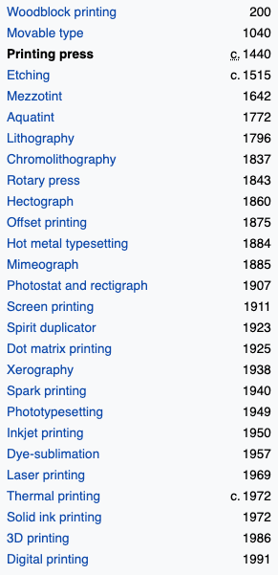
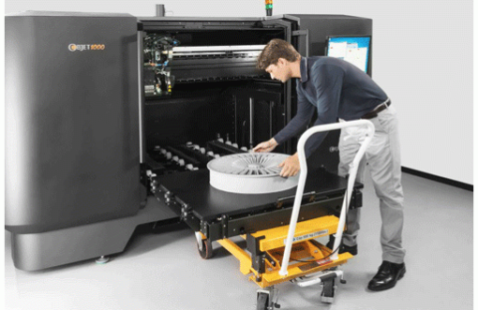
Evolution of Printing
➔
➔
➔
➔
➔
➔
➔
Notes:
Comments

Slide 31
The Publishing Process
Author creates manuscript and sends to journal scientific editor
Scientific editor decides yes/no for consideration to publish—if yes…
Scientific editor sends manuscript to 2-4 reviewers (experts in the specific area of investigation)—the peer review process
Reviewer  Scientific editor  Author revises manuscript based on reviewers’ comments
Notes:
Comments

Slide 32
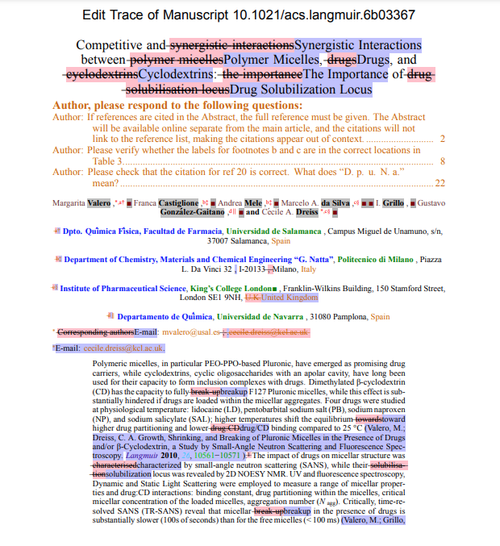
The Publishing Process (cont.)
The scientific editor rejects the manuscript or sends it to a production editor
Production editor redacts/marks-up manuscript
Manuscript keyboarded or word processor file* ➔ composition system
Tables, math, chemical structures, graphics, etc. are processed
* Microsoft Word most common; several other software
packages are accommodated (TeX in mathematics)
Notes:
Comments

Slide 33
The Publishing Process (cont.)
Article proof created
checked by production editor
sent to author
Author returns corrected proof to production editor
Article assigned to an issue and placement
The issue is prepared for printing through composition system
Notes:
Comments

Slide 34
Creation of Printed Journal
From the composition system—forms are prepared for printing…
for 4-up, 8-up, 16-up printing (signatures)
Issue printed
Pages trimmed and bound
Issue mailed
Notes:
Comments

Slide 35
Notes:
Comments

Slide 36
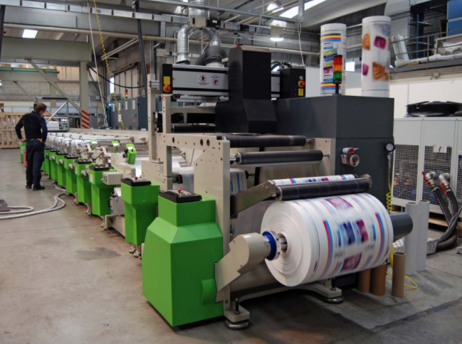
Notes:
Comments

Slide 37
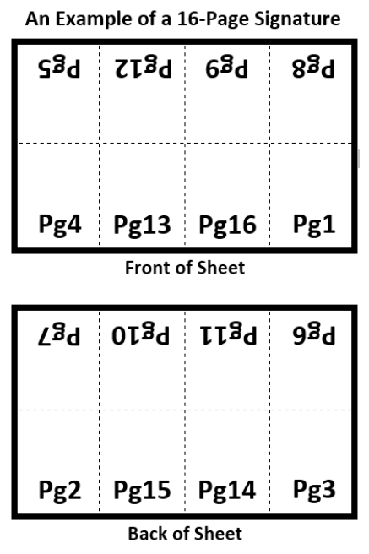
Signatures
are folded,
trimmed and
bound to make
the issue
8 pages
on one
side 
8 pages
underneath 
Notes:
Comments

Slide 38
Electronic Version Preparation
Processing done on an article-by-article basis from the composition system
Indexing elements extracted from composition system (title, author, affiliation, year, abstract, text, etc.)
PDF file created
HTML file created
Index created from extracted elements
Article loaded in RDBMS, server, etc.
Notes:
Comments

Slide 39
The challenges on the road
to electronic publishing?
Notes:
Comments

Slide 40
How Long for Development?
My first estimate in 1974—2 to 3 years
On second thought in 1975—4, 5, maybe 6 years
Oh so naïve—it took 28 years!
Notes:
Comments

Slide 41
Challenges to Electronic Publishing
Many technical Issues
Requirement for print and electronic journals
Differing philosophies among stakeholders…
“Electronic is the wave of the future”
“If it ain’t broke don’t fix it” “Paper forever!”
Internal fiefdoms and power struggles
Competition for resources (R&D is expensive)
Notes:
Comments

Slide 42
Ah… … the Technical Challenges
Notes:
Comments

Slide 43
Availability of Computers
1974—no PCs or Apple computers, no iPads
1970—a IBM System 370 introduced
1975—Microsoft established
1976—Apple founded
1970s—Apple I & II, TRS-80, Commodore
1980s—IBM PC, Dell, HP, Apple (labs and libraries)
In 1980s computers still not ubiquitous
Notes:
Comments

Slide 44
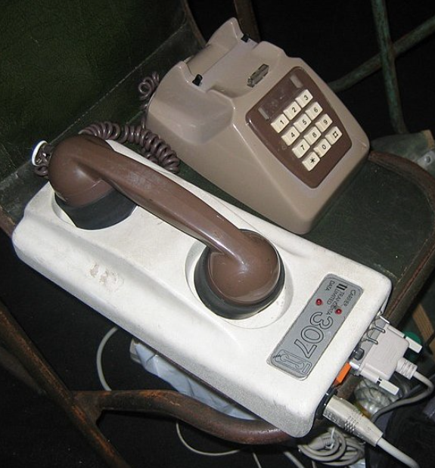
Telecommunications
1980—Communications over phone lines* at 300 baud= 300 bits/sec = 0.0003 Mbps
ACR article 121 KB (PDF)—requires 53 min 47 sec to download
3.5 MB photo (JPEG)—requires 25.93 hours to download
* Using an acoustic coupler
Notes:
Comments

Slide 45
Telecommunications (cont.)
1984—ACS established T1 lines: Columbus, OH to Tokyo, Japan and Karlsruhe, Germany—1.544 Mbps
ACR article 121 KB (PDF)—requires 0.627 sec to download
3.5 MB photo (JPEG)—requires 18.1 sec to download
T1 shared among numerous tasks and very expensive
Notes:
Comments

Slide 46
Telecommunications (cont.)
Today—My house: 300 Mbps down and 340 Mbps up* (equal to ~200 T1 lines or ~7 T3 lines)
ACR article 121 KB (PDF)—requires 0.00323 seconds to download
3.5 MB photo (JPEG)—requires 0.093 seconds to download
* Verizon FiOS
Notes:
Comments

Slide 47
Cost of Data Storage
1974—75 MB hard disk drive
$12,500 ($44,600 in 2021 dollars)
$594,000/TB
2021—4 TB Hitachi disk drive
$70
$17.50/TB
Notes:
Comments

Slide 48
Cooperative Experiments
1989-1995: CORE project to build a prototype digital library at Cornell University
ACS, Belcore, Chemical Abstracts Service, Cornell University and Ohio Computer Library Center (OCLC)
1992-1997: Red Sage Project another prototype digital library
20 publishers with UC-San Francisco
Efforts made obsolete by WWW & Internet
Notes:
CORE = Chemical Online Retrieval Experiment
World Wide Web established 1989

Slide 49
ACS Highlights for Electronic Publishing
1980—1,000 articles from J. Med. Chem. on BRS* (text only)
1982—all 16 ACS journals on BRS** (text only)
1996—J. Phys. Chem. (100th anniversary) on STN International
______
______
* Bibliographic Retrieval Services. Today sold as LiveLink ECM Discovery Server by Open Text Corporation
** 1974-1980, goal achieved after 8 years?
Notes:
STN = Scientific and Technical information Network

Slide 50
Timeline for Electronic Publishing
(cont.)
1997—presentation to ACS Board of Directors then scientists at ACS National Meeting in Las Vegas
1997—all 26 ACS journals on STN International
2002—all ACS journals, from 1879 forward, on STN International (graphics, math, tables, chemical structures, etc.)
1974 to 2002—28 years!
Notes:
STN = Scientific and Technical information Network

Slide 51
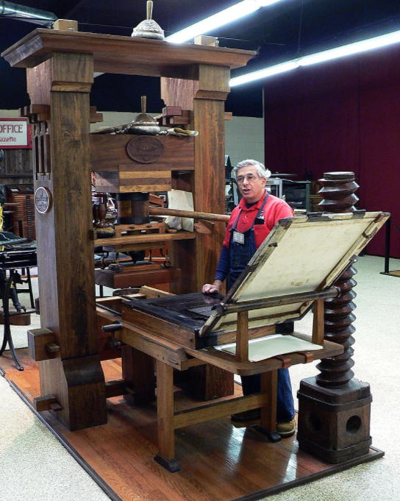
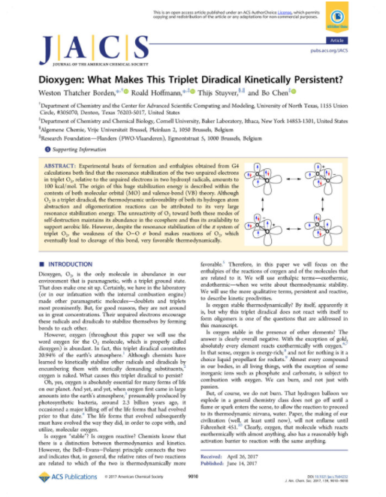
Thanks for your attention!

Notes:
Comments

