Slide 1
Exquisite DNA and Computers
Lorrin R. Garson
PATACS/OPCUG
September 19, 2020
© 2020 Lorrin R. Garson
Notes:
Last edited September 16, 2020 @ 1:15 pm
PowerPoint template from http://www.free-power-point-templates.com

Slide 2
R
A
N
D
O
M

Slide 3
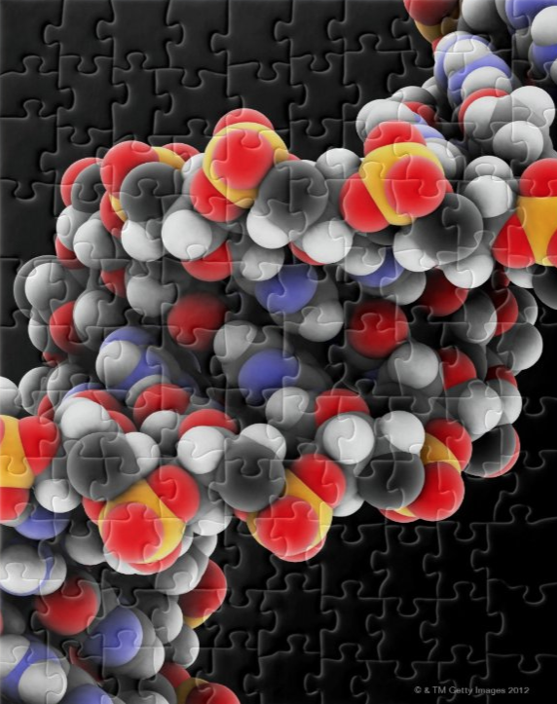
Notes:
The pieces will come together

Slide 4
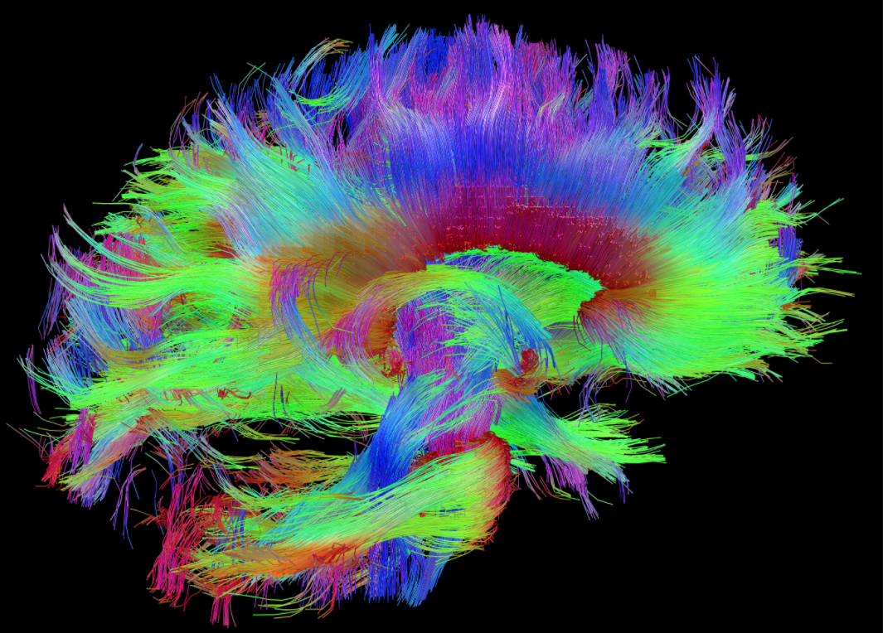
Some surprising connections
Notes:
From https://directorsblog.nih.gov/2015/10/06/making-the-connections-study-links-brains-wiring-to-human-traits/

Slide 5
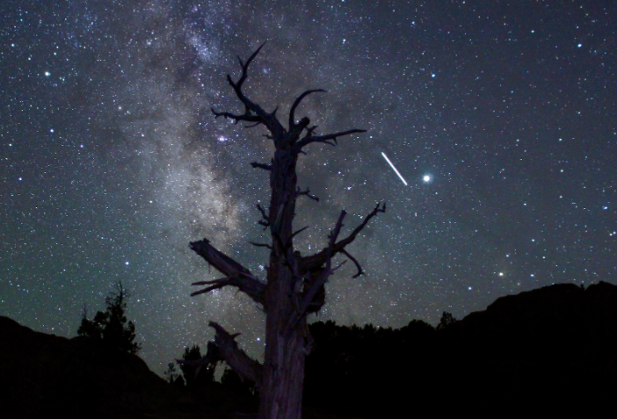
← Milky Way
International Space
← Station
 Jupiter
From NASA
13-second exposure
Notes:
NASA photograph https://solarsystem.nasa.gov/resources/2500/the-view-from-earth-space-station-jupiter-milky-way/
Remember Brian Slawski presented “The Carrington Effect” on August 15th.

Slide 6
Some Astronomical (BIG) Numbers
Size of the Milky Way:
~110,000 lightyears across
~1,000 lightyears thick
1 Lightyear = 5,879 000 000 000 miles (5.879 trillion)
Milky Way contains 250 ± 150 billion stars
Notes:
Speed of light = 186,282 miles/second or 299,792 km/sec
Seconds in a year = 31,557,600

Slide 7
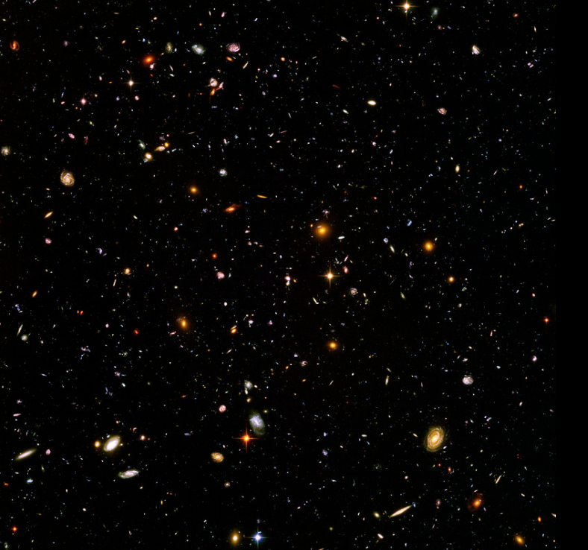
Hubble Ultra Deep Field
A “core sample” of the universe
1/17th of a degree
 Active hypertext link
⇒
~10,000 galaxies
⇒
Notes:
Galaxies 1 to 13 billion lightyears distant
A NASA photo. See https://en.wikipedia.org/wiki/Hubble_Ultra-Deep_Field#/media/File:Hubble_ultra_deep_field_high_rez_edit1.jpg
Don’t forget Robert (Bob) Williams

Slide 8
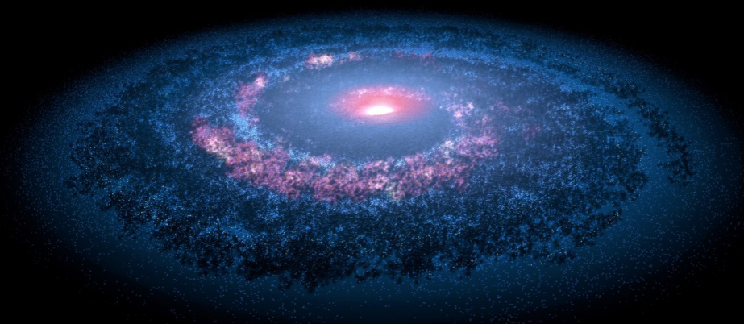
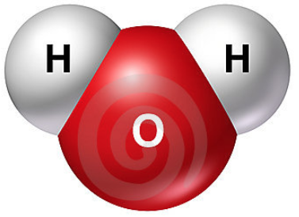
Comparing the Humongous With the Itsy-Bitsy
* A more accurate number is 7.58133 x 10²⁴ in 8 oz.
6.5 x 10¹⁷ miles wide
5.9 x 10¹⁵ miles thick
0.27 nm across
0.000 000 0106 in. across

Slide 9
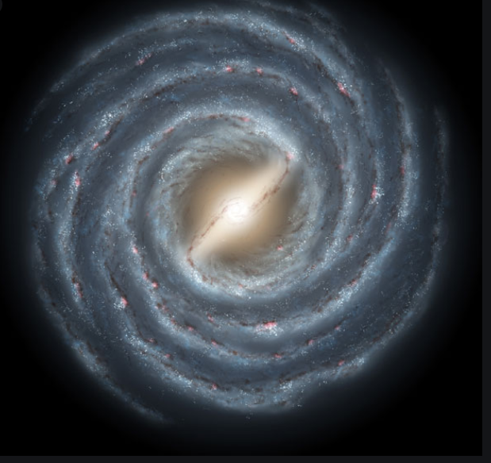
Milky Way—a Spiral Galaxy
 our sun
(Orion Spur)
Notes:
About 70% of all galaxies are spiral galaxies.
In the 16th century (1500s) most people believed the earth was the center of the universe

Slide 10
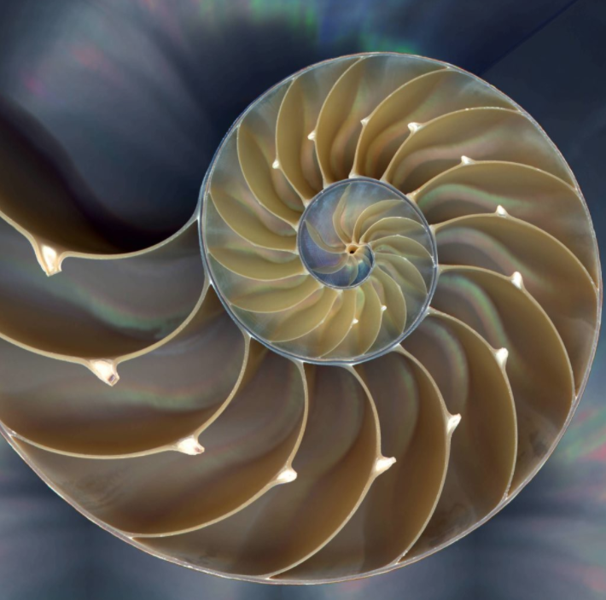
Chambered Nautilus Shell
Nautilus pompilius
8
13
5
21
3
1
34
2
1
Chamber volume = 0, 1, 1, 2, 3, 5, 8, 13, 21, 34 …*
* After Leonardo of Pisa, “Fibonacci”, 1170-1250 AD
Notes:
https://somanautiko.com/embracing-the-sacred-symbol-of-the-chambered-nautilus/#page-content
As the creature grows, it creates a new chamber to occupy. A Fibonacci number
AKA the Chambered Nautilus

Slide 11
[
[
[
[
Chamber volume = 0, 1, 1, 2, 3, 5, 8, 13, 21, 34 …
[
[
[
[
1 ÷ 0 ≠ ?
↑
↑
↑
↑
↑
↑
↑
↑
1 ÷ 1 = 1
2 ÷ 1 = 2
Φ = 1.618033988749895… (Phi)
3 ÷ 2 = 1.5
5 ÷ 3 = 1.6667
π = 3.141592653589793… (Pi)
8 ÷ 5 = 1.6000
Φ = ½ + (√5 ÷ 2)
13 ÷ 8 = 1.6250
21 ÷ 13 = 1.6154
34 ÷ 21 = 1.6190
Φ—The Divine Proportion
The Golden Ratio
The Golden Proportion…
Notes:
Φ is called “Phi”—rhymes with pie
Phi, like Pi is an irrational number

Slide 12
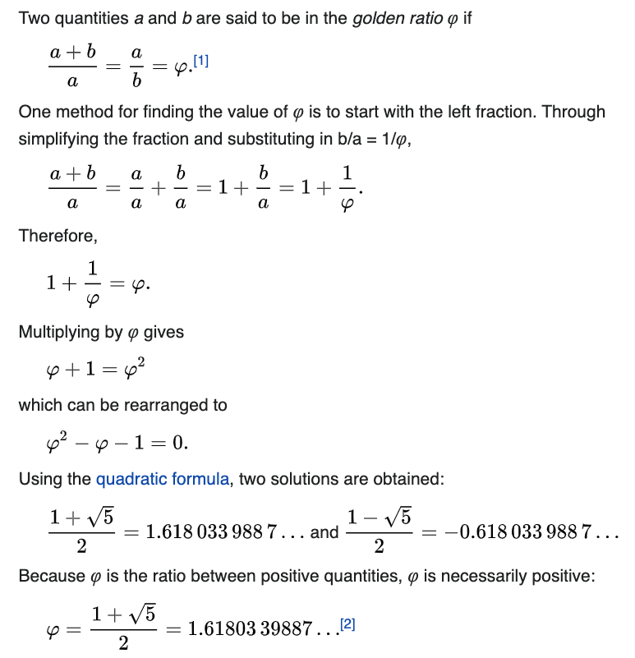
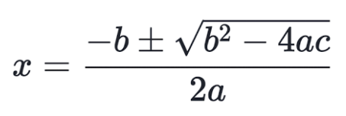
{
From Wikipedia
a = 34; b = 21
(34+21) ÷ 34 = 1.6176
34 ÷ 21 = 1.6190
Φ = 1.618033988749895…

a = 1; b = – 1; c = – 1


Slide 13
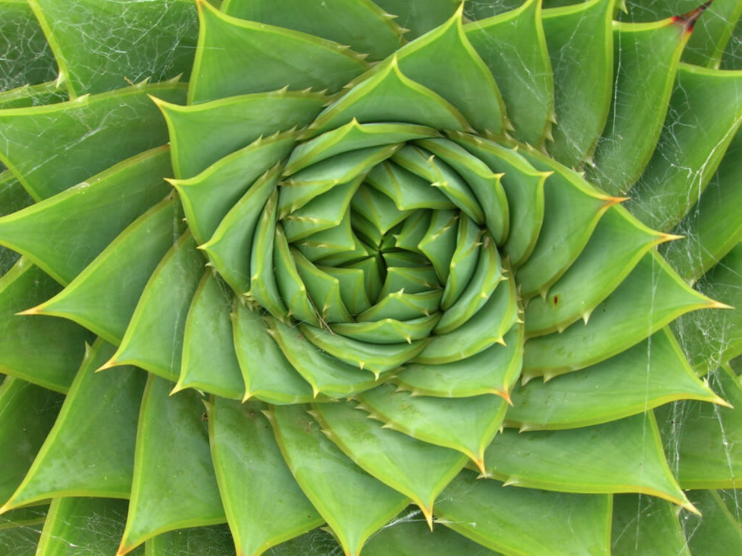
Aloe vera plant
(Aloe barbandensis miller)

Slide 14
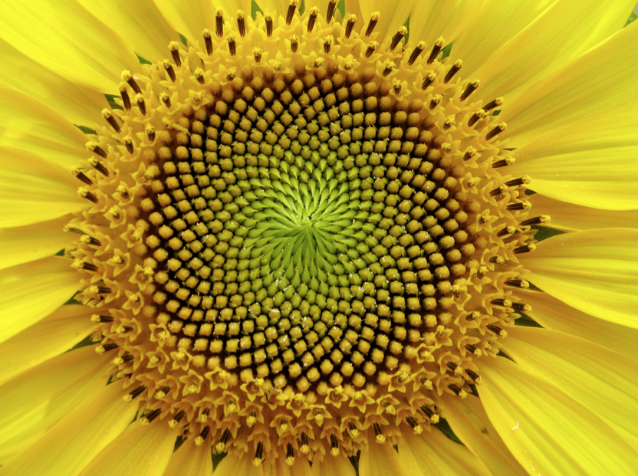
Sunflower
(Helianthus annuus)

Slide 15
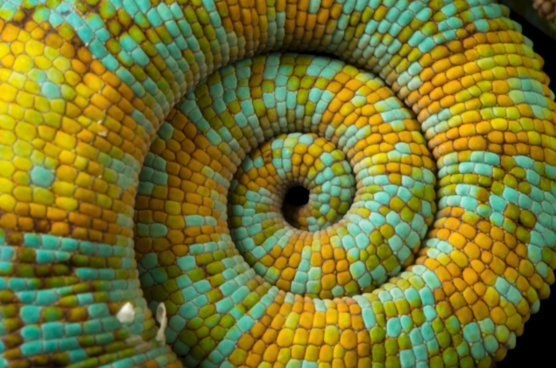
Veiled Chameleon
(Chamaeleo calyptratus)
Notes:
A veiled Chameleon (Chamaeleo calyptratus) in Lincoln, Nebraska

Slide 16
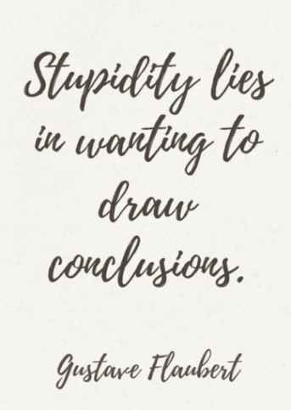
Be careful about
drawing conclusions…
Galaxies are not made
of sunflowers just
because both exhibit spirals

Slide 17
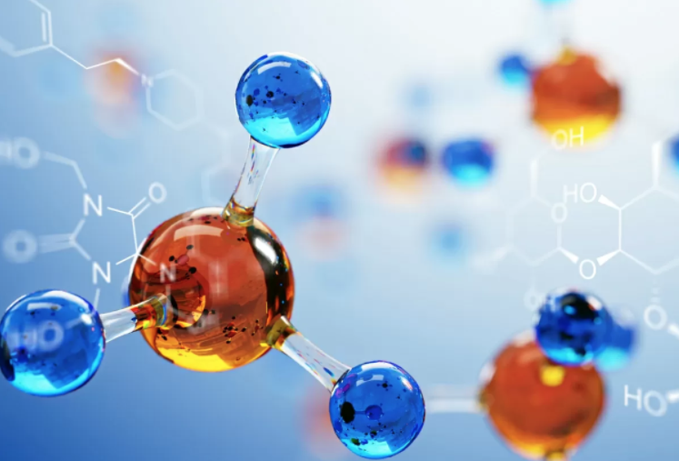
Time to talk molecules

Slide 18
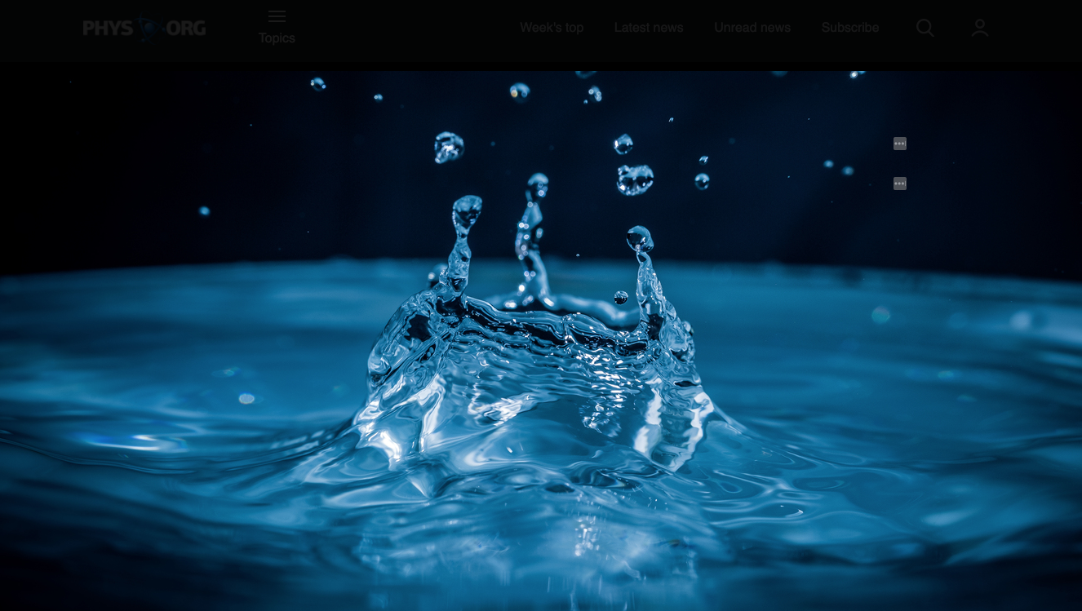
Water—H₂O

Slide 19
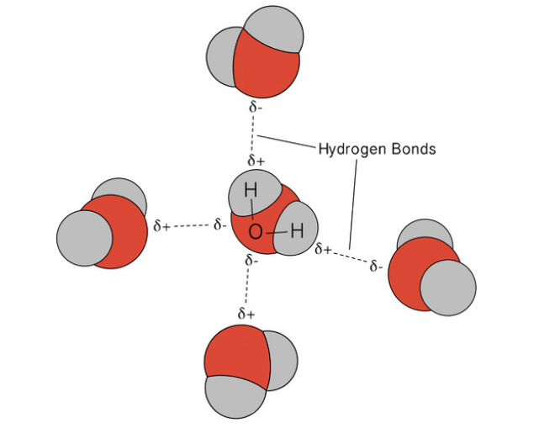
H₂O
BP = 100°C
H₂O
ΔH_{vap} = 9.752 Kcal/mol
H₂S
ΔH_{vap} = 4.463 Kcal/mol
H₂S
BP = –60°C



Notes:
-60C = -76F

Slide 20
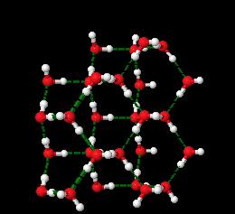
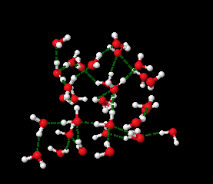
Hydrogen bonding
in liquid water
Hydrogen bonding
in solid water (ice)
ρ = 1.0 g/cm³
ρ = 0.920 g/cm³

Slide 21
DNA—Finally!
DNA is a molecular “blueprint” of who we are, i.e., genetic information
Provides information and regulates the creation of proteins necessary for cells to perform their functions
DNA can self-replicate to pass on itself into new cells (“execution of the blueprint”)
DNA can repair itself, i.e. heal mutations
DNA is a natural medium for information storage
For more information about DNA see

Slide 22
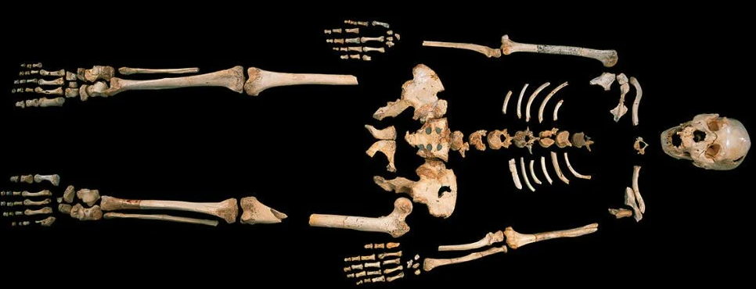
Where is DNA Found?
Humans
Cats, dogs and salamanders
Trees, corn and prunes
Bacteria and viruses*
Buried human bones 400,000+ years old
All living creatures
More information?
see
*Viruses are not living organisms, just complex molecules;
viruses must enter a living cell to multiply

Slide 23
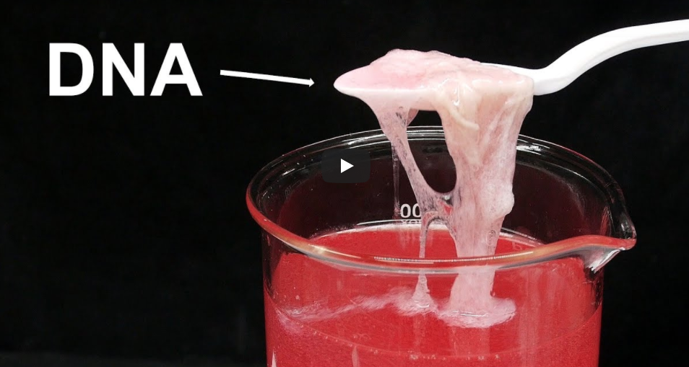
What does DNA look like?
DNA from strawberries

Slide 24
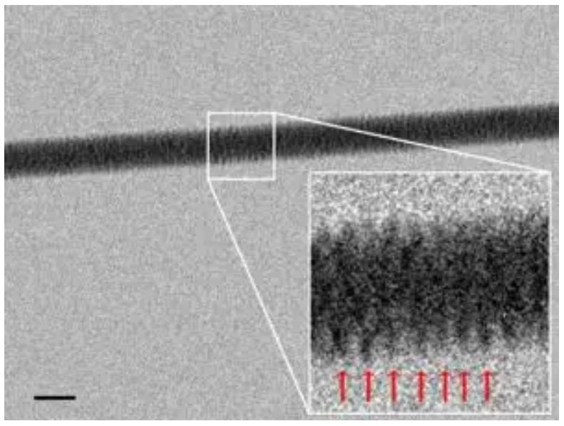
DNA imaged with electron microscope for the first time;
November 28, 2012

Slide 25
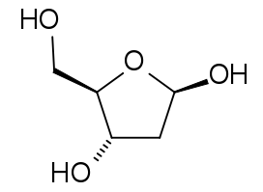
DNA Consists of Only Six Simple Molecules
Phosphoric Acid: H₃PO₄
Deoxyribose: C₅H₁₀O₄
$82/500 ml
$71/25 g
A
G
C
T
Adenine
Guanine
Cytosine
Thymine
C₅H₅N₅
C₅H₅N₅O
C₄H₅N₃O
C₅H₆N₂O₂
$112/25 g
$28/25 g
$273/25 g
$58/25 g

Slide 26
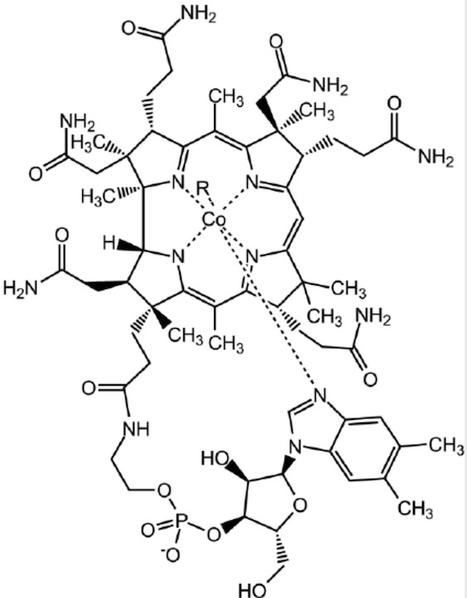
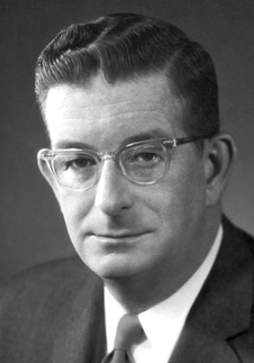
C₆₃H₈₈CoN₁₄O₁₄P
Vitamin B12
(Cobalamin)
Synthesized by
R. B. Woodward
Ph.D. in 1 year from MIT
Nobel Prize in Chemistry
(1965)
Notes:
John von Neumann—1926 Bachelor’s in Chemical engineering and Ph.D. in mathematics at the same time (age 23).

Slide 27
DNA Is a HUGE Molecule
A single human strand is ~5 cm long (~2 in)
How do these six simple molecules fit in?
But first, a little background…

Slide 28
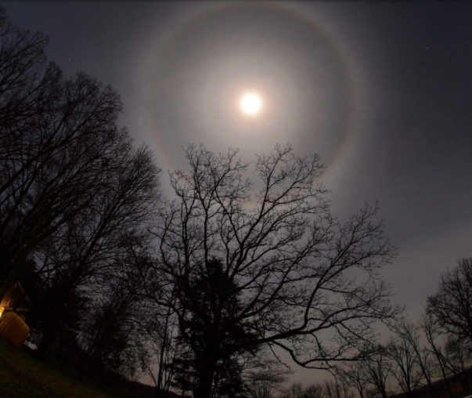
Ring caused by diffraction of light by ice crystals in the atmosphere

Slide 29
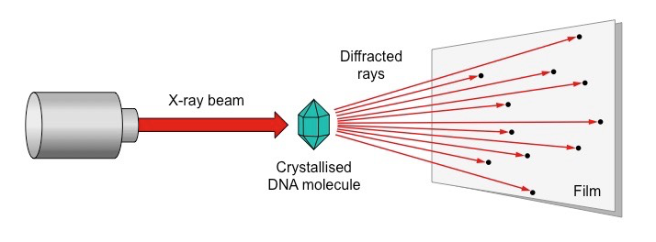
X-Ray Diffraction* of DNA
* Diffraction is the bending of waves around obstacles and openings
Notes:
From https://ib.bioninja.com.au/higher-level/topic-7-nucleic-acids/71-dna-structure-and-replic/structure-of-dna.html

Slide 30
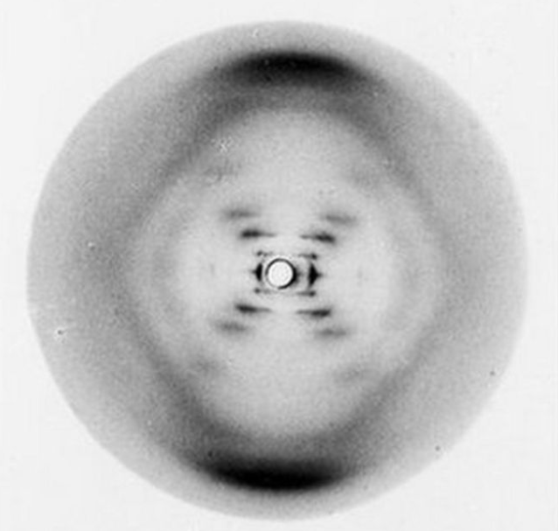
Rosalind Franklin’s X-ray diffraction of DNA
Photo #51
Notes:
From https://www.bbc.com/news/health-18041884

Slide 31
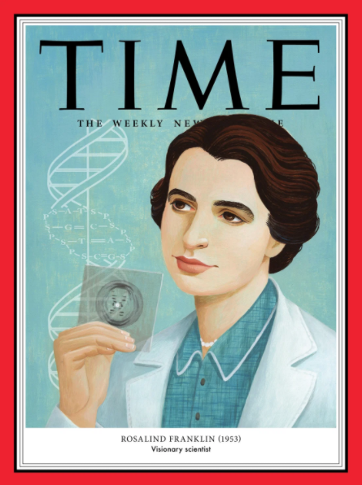
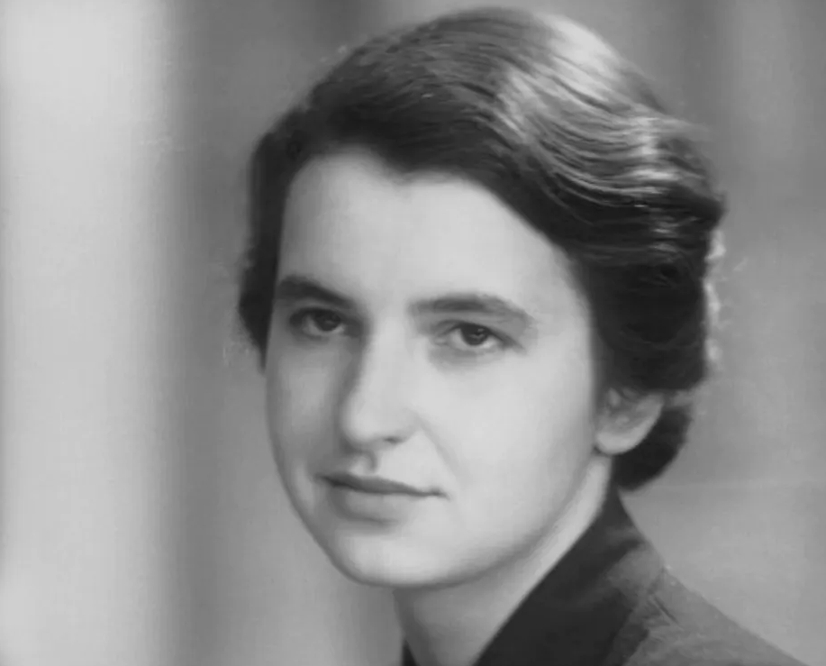
Rosalind Franklin
1920-1958
Age 25
Ph.D. Cambridge University
(physical chemistry)
100 “Women of the Year issue”
Notes:
Died of ovarian cancer at age 38

Slide 32
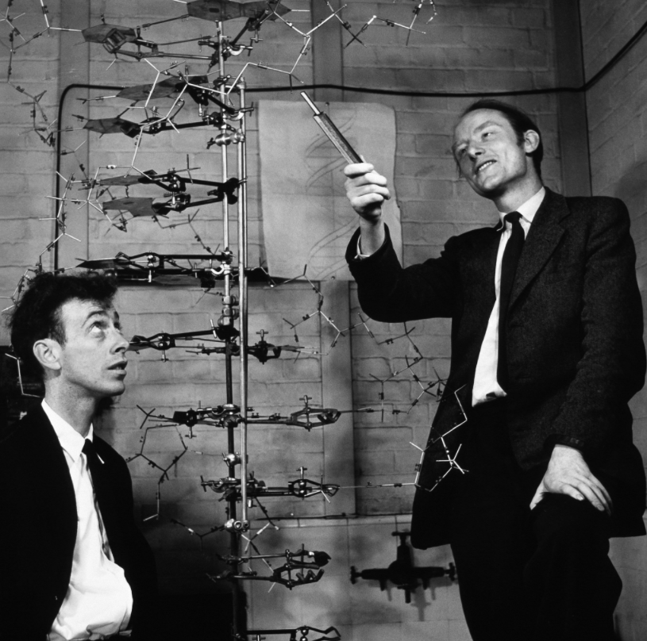
1962 Nobel
in Physiology
or Medicine
with
Maurice Wilkins
James Watson
1928-
Francis Crick
1966-2004
Notes:
Many feel Rosalind Franklin (1920-1958) would have been included in the Nobel award, but the award isn’t given posthumously
Maurice Wilkins (1916-2004)
Linus Pauling (two Nobel Prizes) published an incorrect structure of DNA.
The problem with his triple helix model is that the phosphates form the helical core, with the bases pointing outwards.
Frederick Sanger also won two Nobel Prizes (four individual have received two)

Slide 33
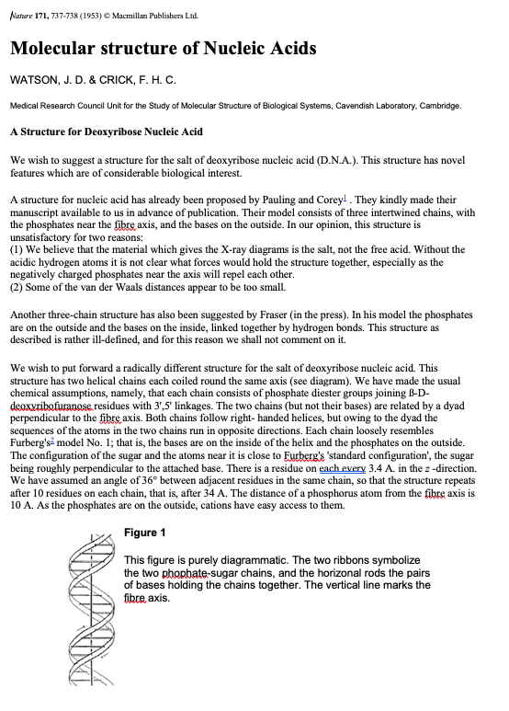
A landmark
paper in science
J. D. Watson & F.H.C. Crick Nature 71, 737-738 (1953)
Notes:
Linus Pauling published (in Nature) an incorrect structure of DNA.

Slide 34
DNA—A Spiral Double Helix
——— 2.1 nm ———
———— 3.4 nm ———
3.4/2.1 = 1.6190
Φ = 1.618033989…
(divine proportion
aka golden ratio)
Φ = ½ + (√5 ÷ 2)
Notes:
21 Å wide; 34 Å long
1 Å =0.1 nm = 0.0000000001 m

Slide 35
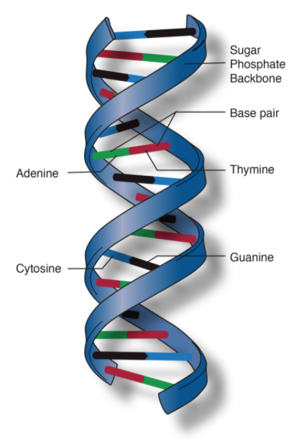
A
T
G
C

Slide 36
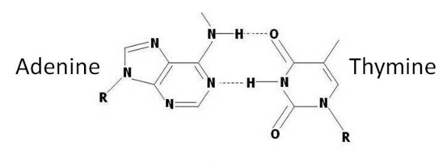
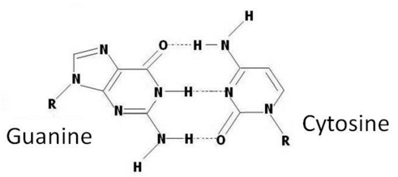
DNA—Bonding Pairs
(A)
(T)
A + T = 1
G + C = 0
Adenine ≠ Cytosine
Guanine ≠ Thymine
(G)
(C)
Notes:
Purines = Adenine (A) and Guanine G)
Pyrimidine = Thymine (T) and Cytosine (C)
Ribose (a 5-carbon sugar)
Phosphoric acid

Slide 37
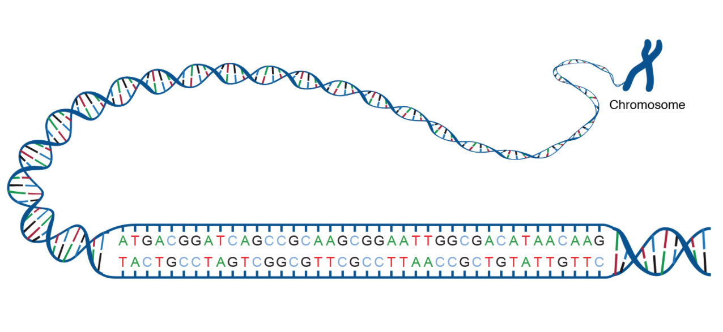
DNA Helical Bonding
A—C—G—T
↑
1
↑
1
↑
1
↑
1
↑
0
↑
0
↑
0
↑
0
A≠C
G≠T
Notes:
From https://www.genome.gov/genetics-glossary/acgt

Slide 38
Has Any Binary Data Been Stored in Synthetic DNA?
The word “hello”
A movie (22 MB) “The Galloping Mare” from 1878
A $50 Amazon gift card
Tolstoy’s novel “War and Peace”
All of Wikipedia in English (16 GB)
Landmark paper by Watson & Crick*
For more information see
* J. D. Watson & F.H.C. Crick Nature 71, 737-738 (1953)

Slide 39
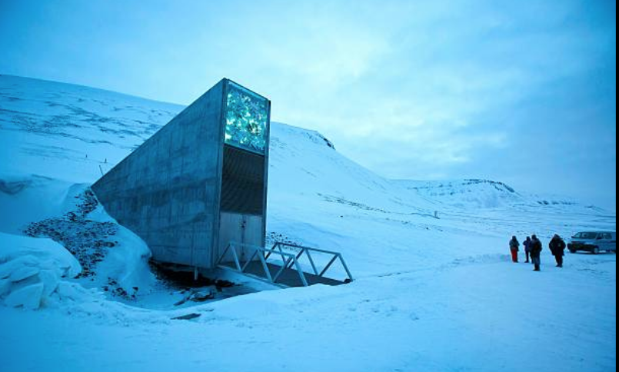
How Much Digital Stuff Can Be Stored in DNA?
~200,000 TB in 1 gram of DNA (~1/28th of an ounce)
In one g DNA—64 billion copies of Tolstoy’s War and Peace
Durable for thousands of years (millions?)
Challenges:
Expensive to encode
Slow to encode and decode
Svalbard Global Seed Vault
Notes:
77.8760 N Svalbard Global Seed Vault

Slide 40
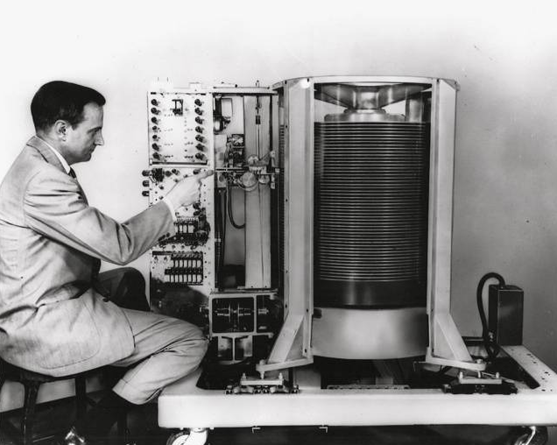
1956
IBM 350 HD
Fifty 24” platters
3.75 MB total capacity
$29,522/month*
to lease
* 2020 dollars
Notes:
First commercial disk drive

Slide 41
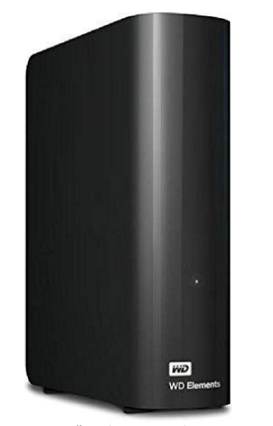
WD Elements HD
12 TB at $217.51
from Amazon
Assuming a 5 year
life expectancy
¢0.0001813 per
MB/5-years

Slide 42
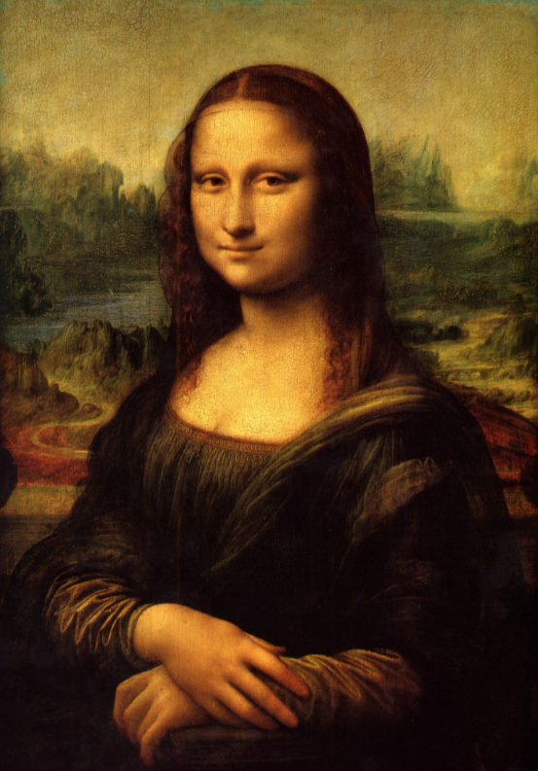
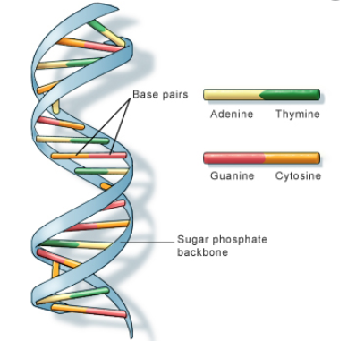
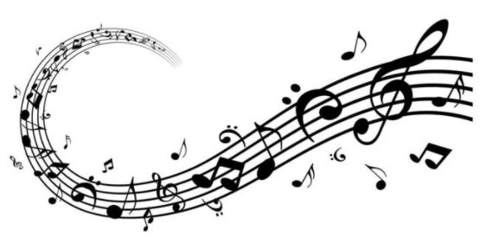
Encoding Data Into DNA
magnetic orientation
or pattern of pits
A—T
1
→
→
G—C
011011001…
0
“Neither a borrower nor a lender be;
for loan oft loses both itself and friend.”
Hamlet Act 1, Scene 3

Slide 43
Writing Data (“printing”) Into DNA
HDD write ~120 Mbps
SSD write ~500 Mbps
Used to encode Wikipedia
(Eng. Ed.) into DNA
“in a handful of hours”

Slide 44
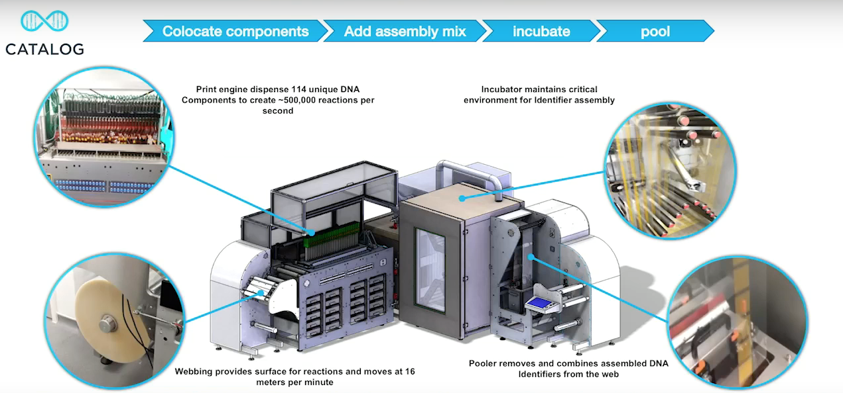
Writing (“printing”) Data Into DNA
1
3
2
4
Notes:
#1Like an inkjet printer spitting out very small dots of ink
#2 The medium on which the small dots are printed.
#3 The chemical reaction environment
$4 The assembled DNA encoded product.

Slide 45
Reading DNA Data
Development of Sequencing Technology
___
Reading the sequences of A+T and G+C… reading the 1s and 0s
An entire human genome can now be read (sequenced)
in 16 hours [>3 billion base pairs (bp)]
HDD reads 160 MB/s or 1280 Mb/s
To read 3 billion bits would take 2.34 seconds

Slide 46
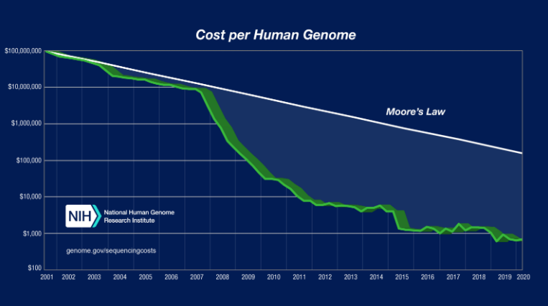
$100,000,000
2001
2020
<$1,000
Notes:
Price of DNA analysis for paternity/ ancestry is $200 to $500

Slide 47
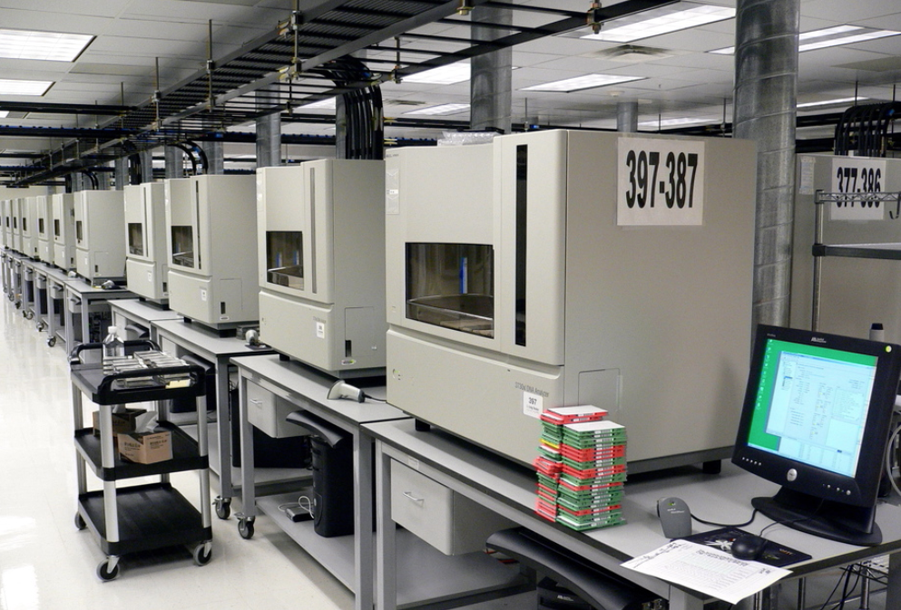
A row of DNA sequencing machines on SteelSentry tables
(3730xl DNA Analyzer machines from Applied Biosystems).

Slide 48
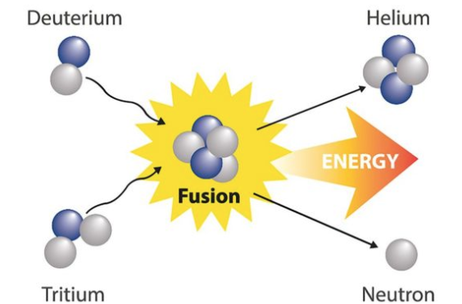
Four Technologies Perpetually 10 to 20 Years Away…
Electricity from nuclear fusion

Slide 49
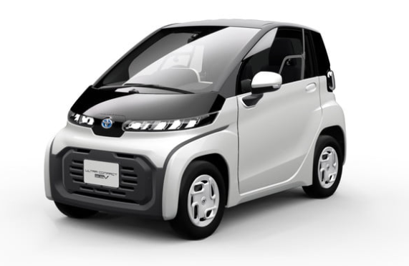
Four Technologies Perpetually 10 to 20 Years Away…
All cars are electric

Slide 50
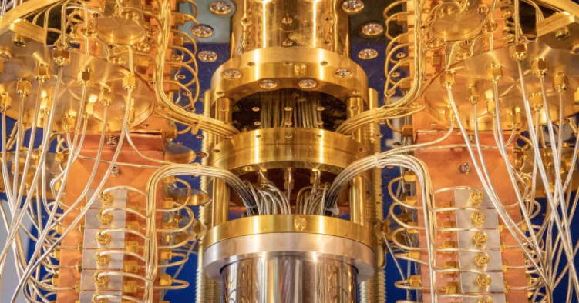
Four Technologies Perpetually 10 to 20 Years Away…
Practical quantum computers
IBM’s 53-qubit quantum computer

Slide 51
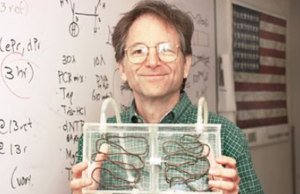
Four Technologies Perpetually 10 to 20 Years Away…
Widespread DNA computers
RSA
Cryptosystem
Rivest
Shamir
Adleman
Leonard Adleman’s DNA-based computer (1994)

Slide 52
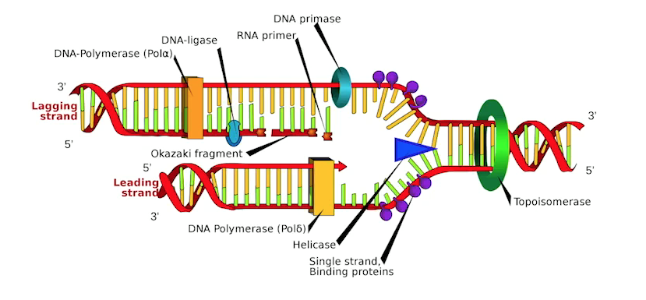
DNA Replication






Chemical reactions occur simultaneously
(Think parallel processing)

Slide 53
Travelling Salesman Problem*
↑
Starting from city #1, salesman must travel to all cities once before returning
The distance between each city is given
Objective: Minimize the total distance to be travelled
↑
Start
↑
↑
* aka Hamiltonian Path

Slide 54
How Many Routes?
For 7 cities; 720 routes
N = (C–1)!
where N = number of routes
C = number of cities
There are about 1.04 x 10⁴⁴ molecules in the earth

Slide 55
Adleman’s DNA Computer Experiment
Demonstration solving the travelling salesman problem
Determine the shortest distance travelling to seven cities
DNA strands are encoded (A—T, C—G) to represent each city
Strands are mixed in a test tube…
Within seconds all possible 720 combinations of DNA strands are created, including the correct answers (i.e., the shortest distances)
The “wrong molecules” are eliminated through chemical reactions (see for details)
Remaining molecules—the distances that connect all seven cities with the shortest total distance

Slide 56
Who is Doing Research on DNA Storage & Computing?

Slide 57
Thanks For Your Attention!
“It’s tough to make predictions— especially about the future” Yogi Berra

